Slide 1
MongoDb Scans
JITHIN JOSE

Slide 2
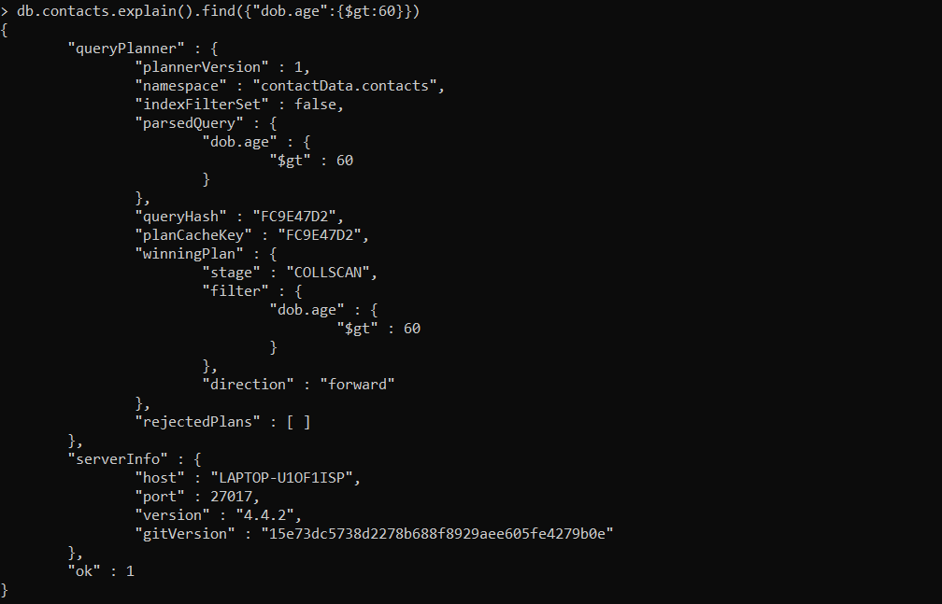
Collection scan

Slide 3
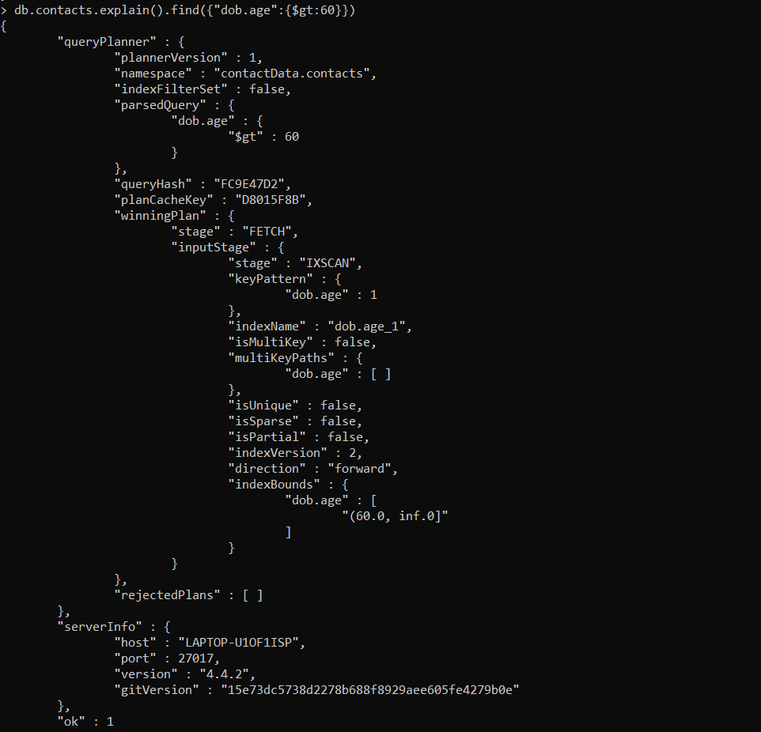
IXSCAN

